Slide 1
Introduction to Computer, Number System & adding/dropping procedure
Course Code: CSC 1101
Course Title: Introduction to Computer Studies
Lecturer No: | 02 | Week No: | 02 | Semester:
Lecturer: | Name& Email

Slide 2
Lecture Outline
List of topics,
Introduction to Computer
IT Essentials-Chapter 1
Number System
Course Adding/Dropping procedure

Slide 3
Specific Objectives
Will have a discussion on,
What is a Computer?
How does Computer work?
Familiarization with basic Input and Output Devices
What is number system
Conversion between various number system(any base to any other base)
Significance of Number system in computing
Discussion about the procedure of course adding and dropping

Slide 4
Introduction to Computer
What is a Computer?
A computer is a programable electronic device, operating under the control of instructions stored in its own memory that can
accept or receive data as input
produce information as output[process the data according to specified rules]
store the information for further use and
retrieve data whenever desired

Slide 5
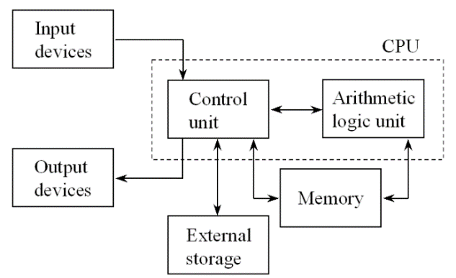
Introduction to Computer
How computer does work?
Let’s consider this simple architecture to understand how computer works,

Slide 6
How computer does work?
Computer works by combining input, storage, processing, and output. All the main parts of a computer system are involved in one of these four processes.
Input
Any information or data sent to a computer for processing is considered as input.
Memory/storage:
Storage is a process through which digital data is saved within a data storage device by means of computing technology either temporarily or permanently

Slide 7
How computer does work?
Processing:
Known as the central processing unit(CPU) and brain of the computer. It is responsible for all functions and processes and most important element of a computer system. Main Parts of CPU are,
Arithmetic Logic Unit(ALU)
Control Unit(CU)
Output:
Anything that comes out of a computer considered as output. it can be meaningful information and may appear in a variety of forms –
binary numbers
Characters
Pictures
printed pages

Slide 8
I/O Devices
Input Device
Input device is a piece of computer hardware equipment to provide data and control signals to an information processing system such as a computer or other information appliance. Some of most common input devices are-
Keyboard
Mouse (pointing device)
Microphone
Touch screen
Scanner
Webcam, etc.

Slide 9
I/O Devices
Output Device
An output device is a piece of computer hardware equipment used to-
communicate the results of data processing
converts the electronically generated information into human readable form.
Some of common output devices are-
Monitor
Speaker
Printer
Projector

Slide 10
IT Essentials
Chapter-1
Chapter 1: Introduction to Personal Computer Hardware
We will find more details description in the CISCO modules which are available on CISCO account.

Slide 11
Number System
What is number system?
Number System is a technique which defines how to represent a number in the computer system architecture.
Defines how same number can be represented differently in different number system using distinct symbols.

Slide 12
Number System
Types of number system?
Two types number system we have
Non-positional number systems
Positional number systems

Slide 13
Types of Number System
Non-positional number systems
Use symbols such as I for 1, II for 2, III for 3, IIII for 4, IIIII for 5, etc.
Each symbol represents the same value regardless of its position in the number
The symbols are simply added to find out the value of a particular number
It is difficult to perform arithmetic with such a number system

Slide 14
Types of Number System
Positional number systems
Use only a few symbols called digits
These symbols represent different values depending on the position they occupy in the number
The value of each digit is determined by:
1. The digit itself
2. The position of the digit in the number
3. The base of the number system
The maximum value of a single digit is always equal to one less than the value of the base

Slide 15
Types of Number System
Positional number systems
Some examples of Positional Number System,
Binary number system
Octal number system
Decimal number system
Hexadecimal (hex) number system

Slide 16
Positional Number System
Decimal number systems
A positional number system
Has 10 symbols or digits (0, 1, 2, 3, 4, 5, 6, 7,8, 9). Hence, its base = 10
The maximum value of a single digit is 9 (one less than the value of the base)
Each position of a digit represents a specific power of the base (10)
We use this number system in our day-to-day life

Slide 17
Positional Number System
Binary number systems
A positional number system
Has only 2 symbols or digits (0 and 1). Hence its base = 2
The maximum value of a single digit is 1 (one less than the value of the base)
Each position of a digit represents a specific power of the base (2)
This number system is used in computers

Slide 18
Positional Number System
Octal number systems
A positional number system
Has total 8 symbols or digits (0, 1, 2, 3, 4, 5, 6, 7).Hence, its base = 8
The maximum value of a single digit is 7 (one less than the value of the base
Each position of a digit represents a specific power of the base (8)

Slide 19
Positional Number System
Hexadecimal number systems
A positional number system
Has total 16 symbols or digits (0, 1, 2, 3, 4, 5, 6, 7,8, 9, A, B, C, D, E, F). Hence its base = 16
The symbols A, B, C, D, E and F represent the decimal values 10, 11, 12, 13, 14 and 15 respectively
The maximum value of a single digit is 15 (one less than the value of the base)

Slide 20
Number System
Conversion
Decimal to Binary
Binary to Decimal
Octal to Binary
Binary to Octal
Hexadecimal to Binary
Binary to Hexadecimal
Converting a number of any base to a number of another other base

Slide 21
Number System
Significance of Number System in Computing
In order to understand the language used by computers and other digital system it is crucial to have a better understanding of number system.

Slide 22
Course Adding/ Dropping Procedure
1. All ADD/DROP procedure can be completed online.
2. Login into the VUES account Click ADD/DROP button Select the courses to ADD/DROP Click CONFIRM button.
3. Full Course Fee should be paid for the Added Courses within 24 hours. The printout for the payment must be collected from the concerned department.
4. 10% Penalty will be charged for dropped course.

Slide 23
Course Adding/ Dropping Procedure
5. Minimum load should be maintained even after dropping (as per following table):
6.Adding / Dropping is not allowed for PROBATION STUDENTS.
7. A student can Add or Drop a course after first week of a semester.
8. In case of less than 12 credits approval must be taken from Dean / Director.

Slide 24
Books
Computer Fundamentals by Pradeep K. Sinha & Priti Sinha
http://mycsvtunotes.weebly.com/uploads/1/0/1/7/10174835/computer_fundamental_complete-i.pdf

Slide 25
References
https://www.explainthatstuff.com/howcomputerswork.html#computer
https://www.gr8ambitionz.com/2015/01/how-computers-work.html
http://www.just.edu.jo/~mqais/CIS99/PDF/Ch.01_Introduction_%20to_computers.pdf
https://www.techopedia.com/definition/1115/storage
https://www.webopedia.com/TERM/O/output.html

